Slide 1

OPTIMISATION OF COEFFICIENTS IN SEMI EMPIRICAL MASS FORMULA USING LIQUID DROP MODEL
SUBMITTED BY
ANANYA N
HIBA PARVIN P
RITHU RAJESH
SOURAV P
SOURAV PAROL
UNDER THE GUIDANCE OF
Dr. DHANARAJ P V
Department of Physics
MALABAR CHRISTIAN COLLEGE
2023-24

Slide 2
PREFACE
The goal of the project is optimisation of coefficients in semi empirical formula using liquid drop model. Optimisation is done by least square method using python programming by fitting experimental data on liquid drop model.
The dissertation is divided into 4 chapters:
Chapter 1 : Nuclear structure and properties
Chapter 2 : Binding energy and nuclear models
Chapter 3 : Liquid drop model and semi empirical formula
Chapter 4 : Methods and results

Slide 3
CHAPTER 1 : NUCLEAR STRUCTURE AND PROPERTIES
Atom
Basic unit of matter
Consists of nucleus surrounded by electrons
Electrons are bound to the nucleus by the electromagnetic force
Electrically neutral. Otherwise exists as an ion
Represented by _{Z}X^{A}
Z : atomic number
A : mass number
A = Z + N (N : no.of neutrons)
Nucleus
Tiny central core of the atom
Consists of protons and neutrons known as nucleons
Almost entire mass of the atom is concentrated in it
Size : 10 ⁻¹⁵ m

Slide 4
Nuclide
Any atomic nucleus with a specific no.of atom Z and mass number A
Isotopes & isobars
Isotopes : Nuclei with same no.of protons but different no.of neutrons
₁₄Si²⁸, ₁₄Si²⁹, ₁₄Si³⁰
Isobars : Nuclides with mass number but different atomic number
₈O¹⁶, ₇N¹⁶
Properties of nuclei
Nuclear size
Nuclear mass
Nuclear density
Nuclear charge
Nuclear forces
Nuclear stability

Slide 5
CHAPTER 2 : BINDING ENERGY AND NUCLEAR MODELS
Mass defect
Difference between actual atomic mass and sum of the masses of the nucleons
Δm = [(Zm_{p} + Nm_{n}) - M]
(Zm_{p} + Nm_{n}) : sum of the masses of the nucleons
M : actual mass of the nucleus
This mass defect can be converted into energy using the mass-energy equivalence formula
E = mc²
E = Δmc²

Slide 6
Binding energy
The energy equivalent to the mass defect of a nucleus is called binding energy.
BE = Δmc² = {(Zm_{p} + Nm_{n}) - M} c²
It is the energy required to separate an atomic nucleus completely into its constituent protons or neutrons, or, the energy liberated by combining individual protons and neutrons into a single nucleus.
If BE > 0 : nucleus is stable and energy must be supplied from outside to split it into constituents
If BE < 0 : nucleus is unstable and it will disintegrate by itself
BE per nucleon = total BE of a nucleus / number of nucleons.
It is plotted as a function of mass number A.

Slide 7
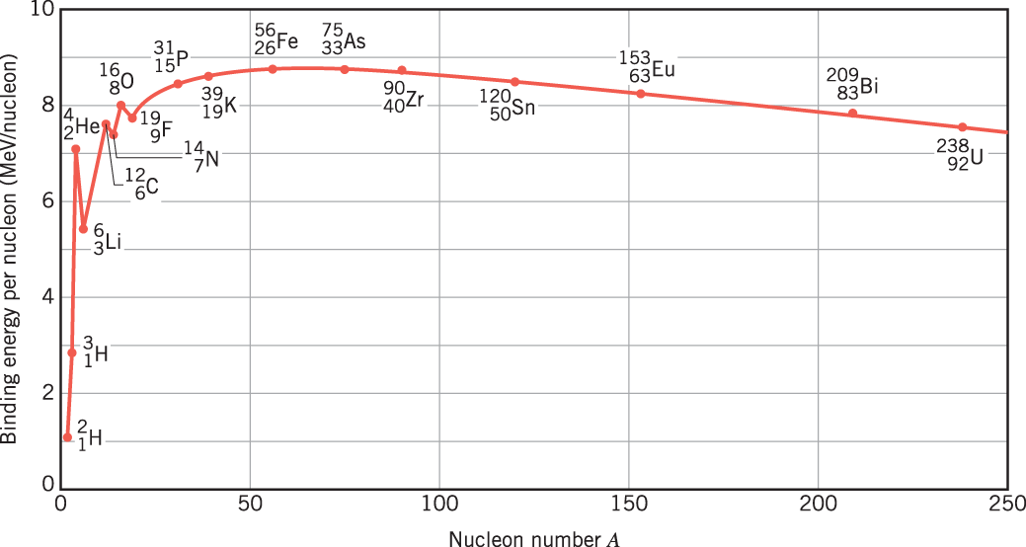
Binding energy per nucleon curve
The curve increases steeply and teaches a maximum of 8.8 MeV at A = 56 (for Fe), then drops slowly to about 7.6 MeV at the highest mass numbers.
Large amount of energy will be liberated if heavier nuclei split into lighter
ones (nuclear fission) or if light nuclei joined to form heavier ones
(nuclear fusion).

Slide 8
Nuclear models
To explain the behaviour and properties of nuclei
The nuclear models proposed so far can be classified into two broad types
1. strong interaction model - liquid drop model
2. independent particle model - shell model

Slide 9
CHAPTER 3 : LIQUID DROP MODEL AND SEMI EMPIRICAL MASS FORMULA
Liquid drop model
Proposed by Niels Bohr and Fritz Kalckar, it is widely used to explain the binding energy of the nucleus.
Based on the striking similarities between liquid drop and nucleus
shape
balance between two forces
density is independent of its volume

Slide 10
Semi empirical mass formula
Used to calculate the mass and various other properties of an atomic nucleus.
Theory is based on liquid drop model
The formula has five terms which represents the five types of energies, named as :
1. Volume energy
2. Surface energy
3. Coulomb energy
4. Asymmetry energy
5. Pairing energy

Slide 11
Volume energy
When an assembly of nucleons of the same size is packed together into the smallest volume, each interior nucleon has a certain number of other nucleons in contact with it. So, this nuclear energy is proportional to the volume.
E_{v} = a_{v}.A MeV
where A is mass number, A_{v} is constant. Its value is 16.11
Surface energy
A nucleon at the surface of a nucleus interacts with fewer other nucleons than one in the interior nucleus and hence its binding energy is less. This surface energy term takes that into account and is therefore negative and is proportional to the surface area.
E_{s} = a_{s}. A^{2/3} Mev
where A is mass number, a_{s} is constant. Its value is 20.21

Slide 12
Coulomb energy
The electrostatic repulsion between each pair of protons in a nucleus contributes toward decreasing its binding energy.
E_{c} = a_{c} Z² A^{-1/3} Mev
where A is mass number, Z is atomic number, a_{c} is constant. Its value is
0.583
Asymmetry energy
An energy associated with the Pauli exclusion principle. If it wasn’t for the coulomb energy, the most stable form of nuclear matter would have the same number of neutrons as protons, since unequal numbers of neutrons and protons imply filling higher energylevels for one type of particle, while leaving lower energy levels vacant for the other type.
E_{a} = a_{a} ((A-2Z)²/A) MeV
where A is mass number, Z is atomic number, a_{a} is constant. Its value is
20.65

Slide 13
Pairing energy
An energy which is a correction term that arises from the tendency of proton pairs and neutron pairs to occur. An even number of particles is more stable than an odd number.
E_{p} = ± δ/A^{3/4} MeV
where A is mass number, Δ is constant. Its value is 33.

Slide 14
BE - SEMF
E_{B} = [ m_{p} – (A-Z) m_{n}+ E_{v} – E_{s} – E_{c} – E_{a} ± E_{p}] MeV
m_{p} - mass of proton : 1.0072766u
m_{n} - mass of neutron : 1.0086654u

Slide 15
CHAPTER 4 : METHODS AND DISCUSSION
Least square method
It is a standard approach in regression analysis to the approximate solution of over dominated systems, that is, sets of equations in which there are more equations than unknowns.
Least squares mean that the overall solution minimises the sum of the squares of the errors made in the results of every single equation.
The least square fit method is a technique used to estimate the values of the parameters in a mathematical model that best fits a set of data. In the case of the liquid drop model, the parameters are the coefficients a_{v}, a_{s}, a_{c}, a_{a}, and a_{p}.
To use the least square fit method to determine the values of these coefficients, we start by collecting experimental data on the binding energies of a set of nuclei with different mass numbers.

Slide 16
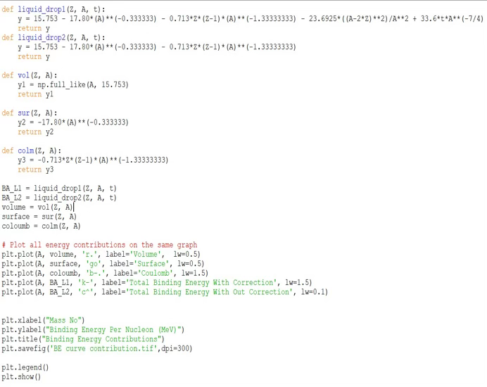
Nuclear binding energy contributions
We plotted contribution terms in semi empirical formula and total binding energy per nucleon with correction factors (asymmetric and pairing terms) and without correction factors using python code.

Slide 17
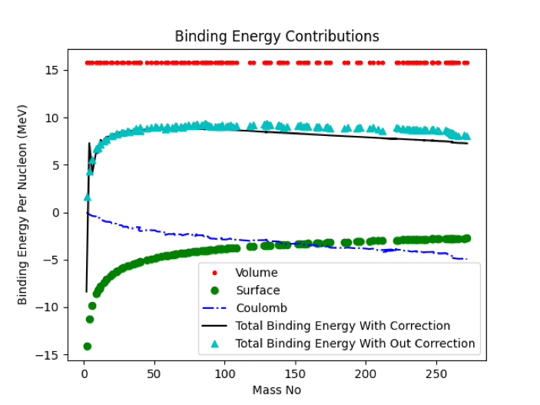
Output:-
Contribution terms : volume energy, surface energy, coulomb energy
Correction terms : asymmetry energy, pairing energy

Slide 18
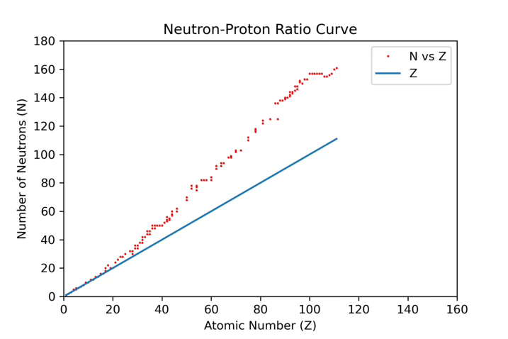
Analysis of correction terms
Asymmetry energy
Due to the difference in no.of protons and neutrons. Determines the stability and properties of atomic nuclei.
lighter nuclei : almost equal no.of protons and neutrons : stable
heavier nuclei : more protons than neutrons : unstable
additional neutrons require to stabilize the nucleus
It can be explained on the basis of neutron-proton ratio curve

Slide 19
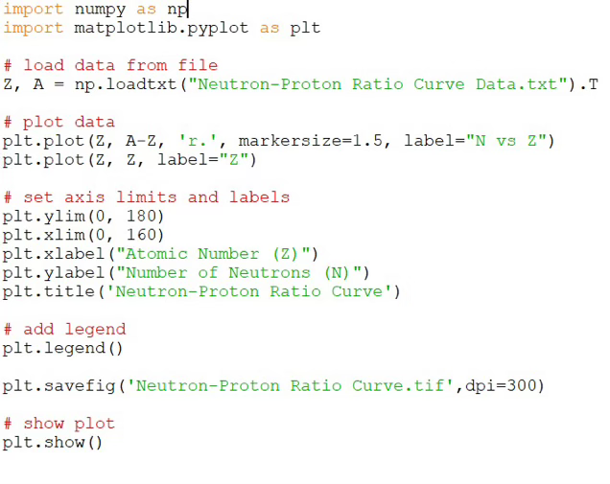
Python code for the plot:-
As proton number increases, nucleus becomes unstable. In order to solve this naturally, no.of neutrons found to be higher than the proton number with increase in atomic number.
Pairing energy
Even no.of particles is more stable than odd number.
E_{p} = ± δ/A^{3/4} MeV
even-even nuclei : +ve
odd-odd : -ve
even-odd/odd-even : 0

Slide 20
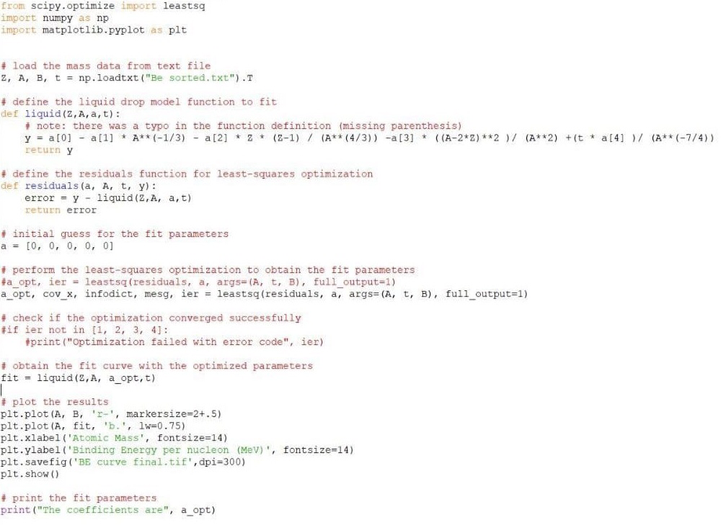
Optimisation of coefficients in semi empirical mass formula using liquid drop model

Slide 21
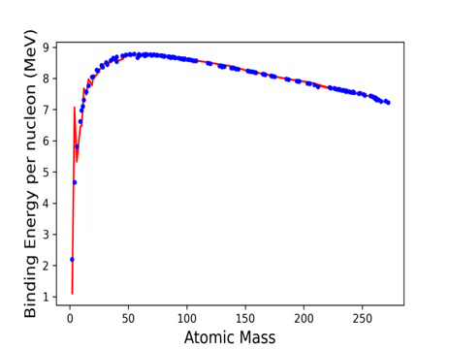
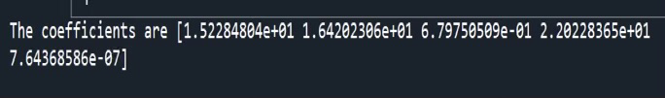
Output:-
Python code we described above gave output for optimized values of coefficients in semi empirical mass formula along with plot of binding energy fit

Slide 22
The coefficients are: -
a_{v} =15.2284804 MeV
a_{s}=16.4202306 MeV
a_{c}=0.679750509 MeV
a_{s}=22.0228365 MeV
a_{p}=7.64368586×10-7 MeV

Slide 23
CONCLUSION
In this study, with our focus on the topics semi empirical mass formula and liquid drop model, we explored the complex world of nuclear physics. The least square method allowed us to optimise the coefficients in semi empirical mass formula to best fit experimental data on atomic masses. From this study, we were able to understand the nuclear binding energies and nuclear stability.

Slide 24
THANKYOU

Slide 25
ADDITIONAL DATA
Atomic mass data :
https://www-nds.iaea.org/amdc/ame2003/mass.mas03

